Slide 1



Data Mining: US Census income data
Pol Casacuberta
He Chen
Eric Hurtado
Tommaso Patriti
Alexandru-Ilie Popa

Slide 2
Index
Overview
Data Mining process
Descriptive analysis
Preprocessing
PCA
Clustering
Proﬁling
Conclusions

Slide 3
Overview
After Sampling and Data Selection
20,000 individuals (rows)
28 features (columns)
Goal
Identify patterns, relationships, and correlations within the data and draw conclusions about the factors that may impact income.
Original Dimension
199,523 individuals (rows)
42 features (columns)

Slide 4
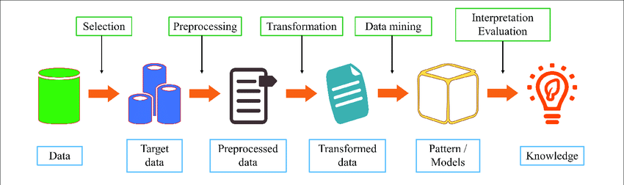
Data Mining Process

Slide 5
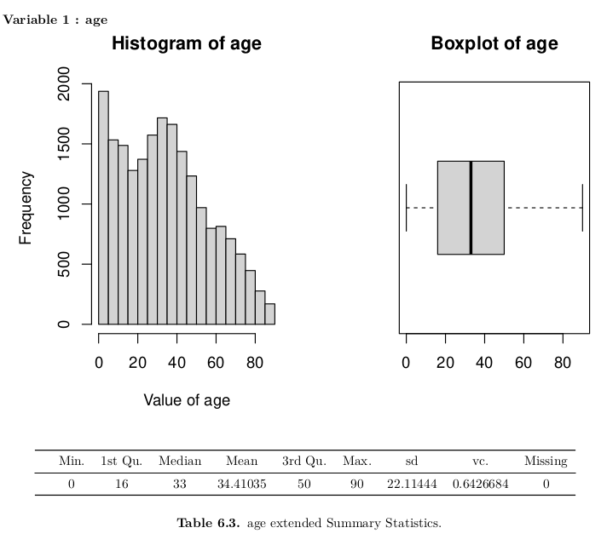
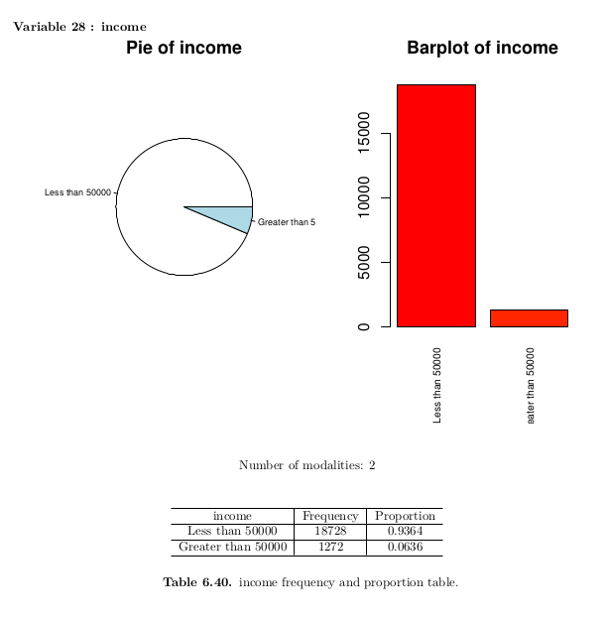
Descriptive Analysis
Univariate Analysis

Slide 6
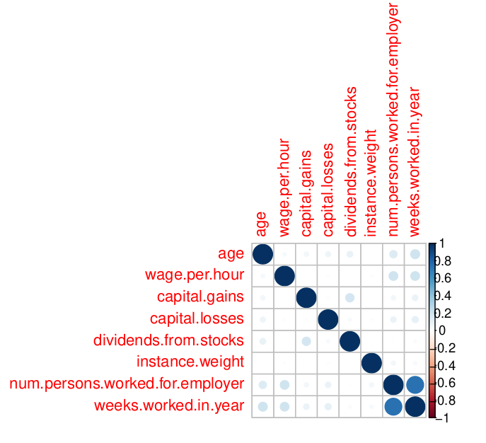
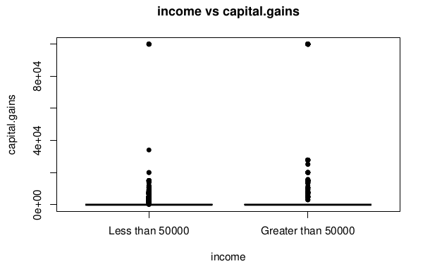
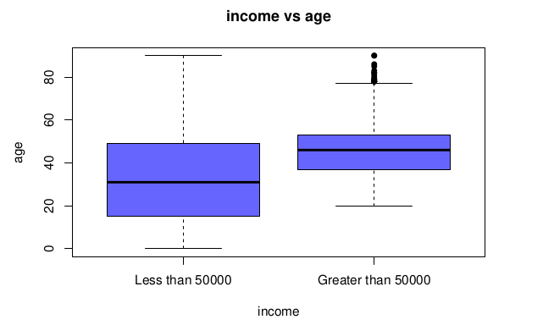
Bivariate analysis

Slide 7
Preprocessing
Feature selection
Remove features that do not contribute any information to the topic
2. Prepare and cleaning data
Convert missing data value
Categorical value to factors
Set levels

Slide 8
Preprocessing
3. Missing data: all categorical data
Group | Description | Strategy
1 | less than 10% | try to impute or create new category
2 | between 50% and 70% | preserve only important features
3 | more than 90% | remove

Slide 9
Preprocessing
Group 1: hispanic origin, country of birth self
Group 2: class of worker, major industry code, major occupation code, live in this house 1 year ago …
Group 3: enrolled in edu inst last wk, member of a labor union, …

Slide 10
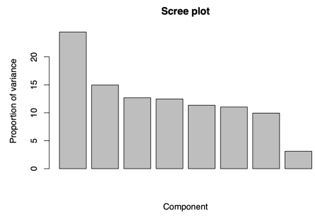
PCA
Similar amount of variance

Slide 11
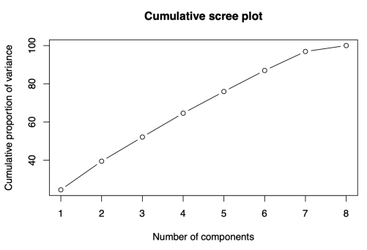
PCA
5 components =~ 80%
We choose 5 PCs to represent our data

Slide 12
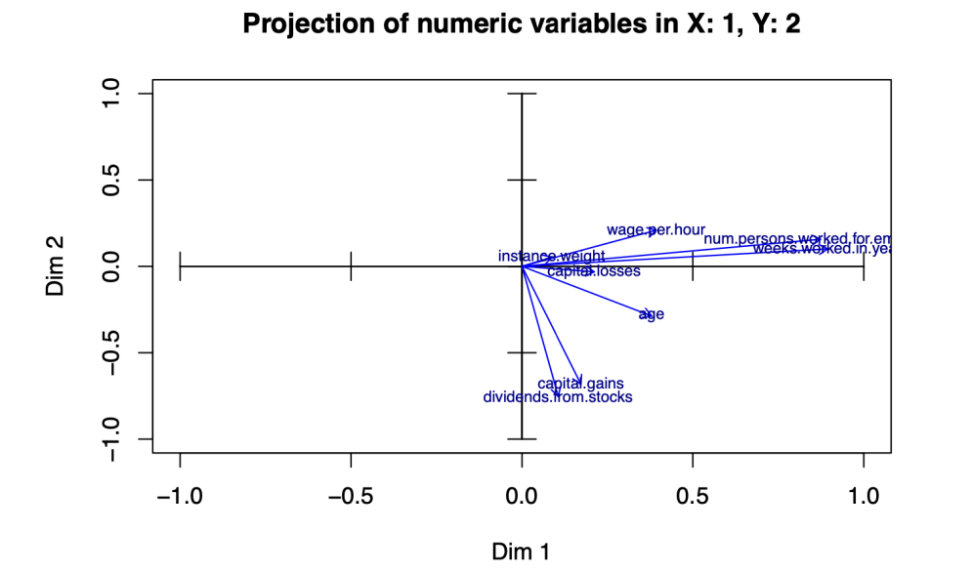
PCA
Most important in y-axis:
Dividends from stocks
Capital gains
Most important in x-axis:
weeks worked in a year
number of persons worked for the employer
Positive correlation between:
capital gains, dividends from stocks and age
Negative correlation y–axis
Wage per hour and age

Slide 13
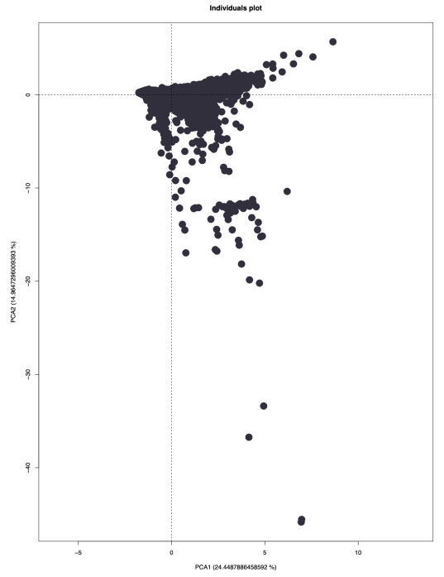
PCA
Most observations are clustered around the center of the plot
Some outliers

Slide 14
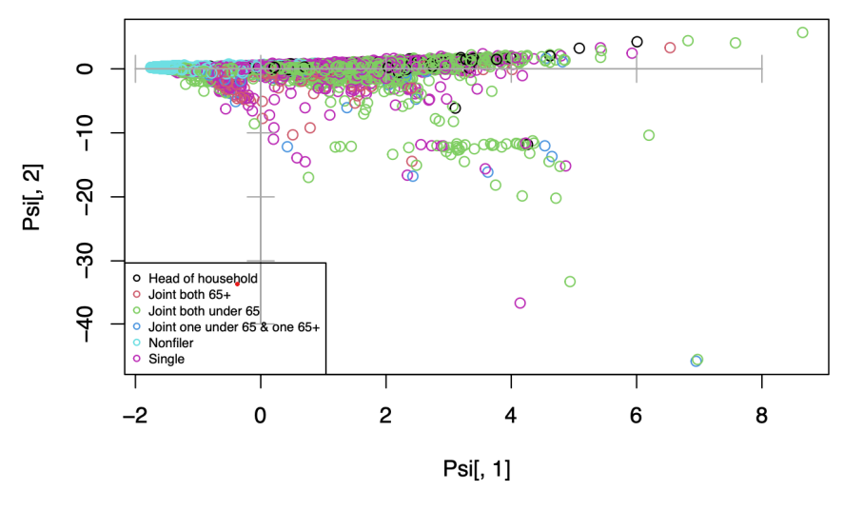
PCA
detailed.household.and.family.stat
Nonfiler: identifies taxpayers who have not filed a federal or state individual income tax return for the tax year under review

Slide 15
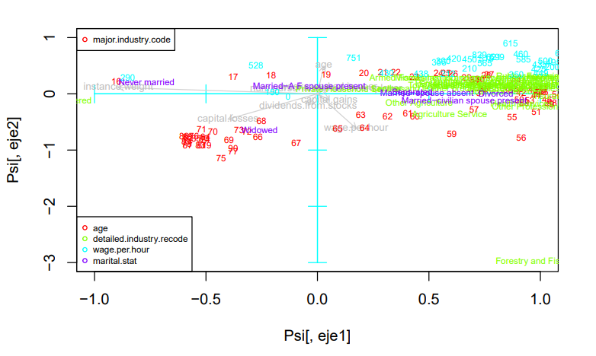
PCA
Centroids for the factors with respect to the principal components
Widowed: their ages tend to be older
Capital loses seem to be highly related with higher ages

Slide 16
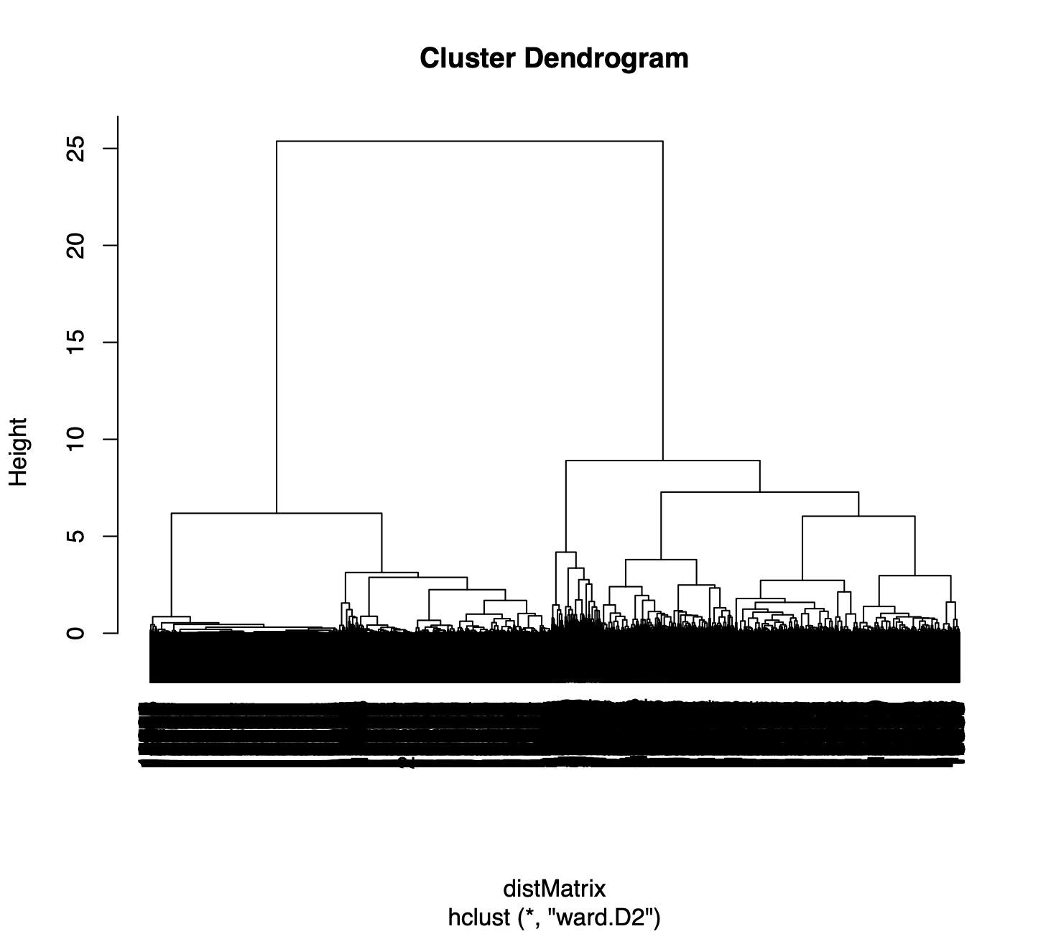
Clustering
method="ward.D2"
metric = "gower"
1 | 2
9923 | 10077

Slide 17
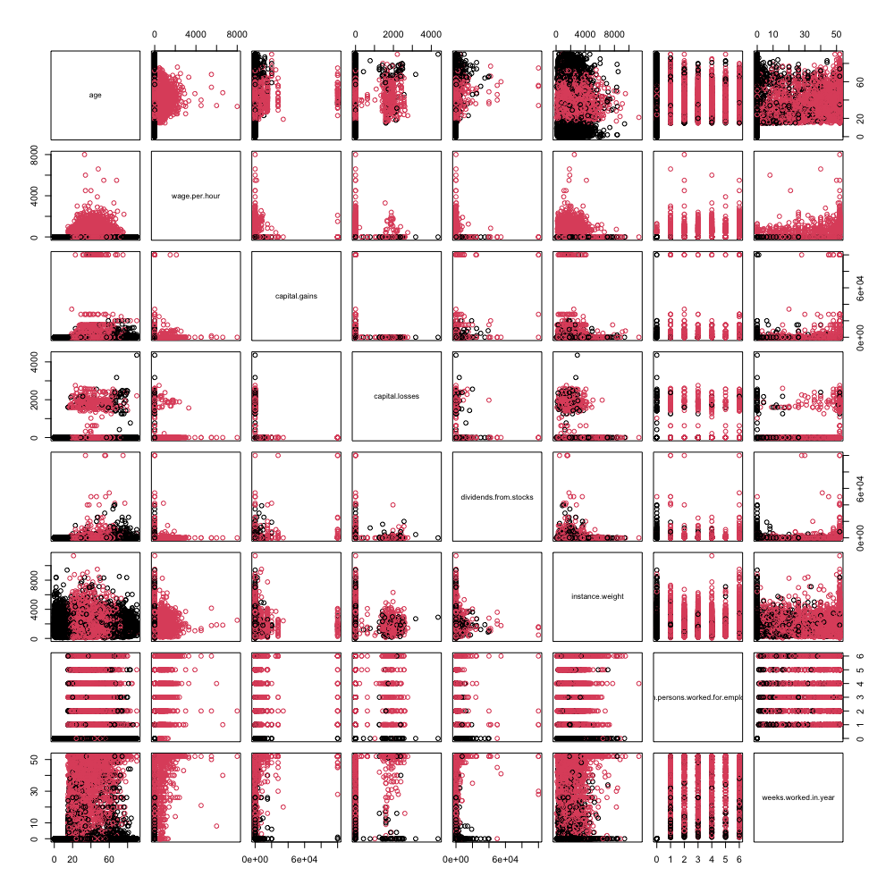
Clustering
Cluster 1 = Age: 0-17 -> 65-90 Cluster 2 = Age: 18-64

Slide 18
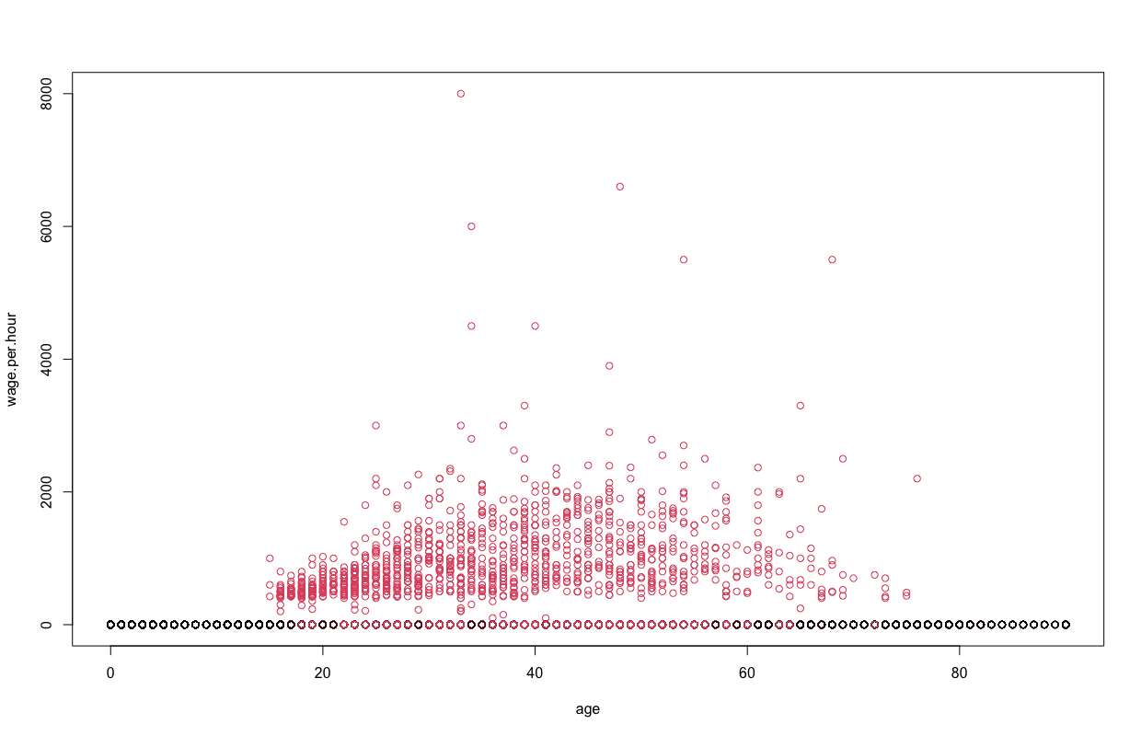
Clustering

Slide 19
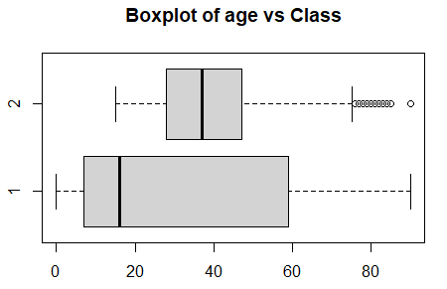
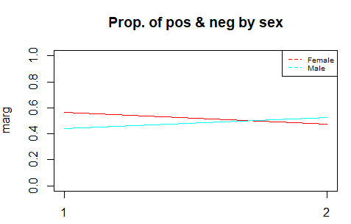
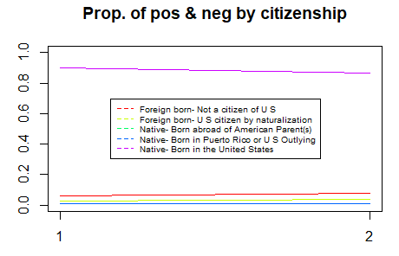
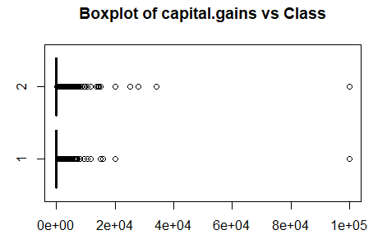
Profiling
Socially, the American society do not have great difference

Slide 20
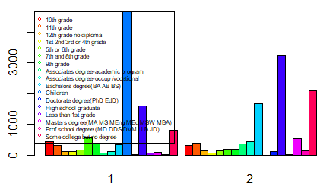
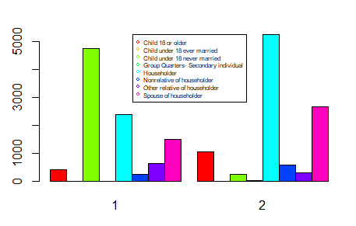
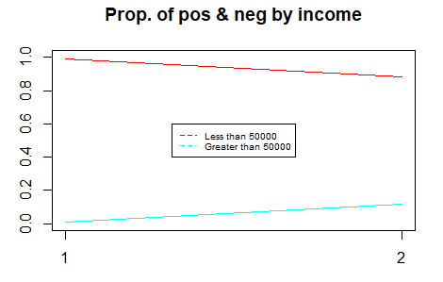
Profiling
There is a generational difference
Education
Household

Slide 21
Final conclusions
Two distinct clusters: Workers and non-workers
Some Categorical variables such as industry are predominantly “not considered”
Income, individuals with greater than $50,000 present less variability with respect to age
Individuals who identify as white have a higher wage per hour compared to other races
The grand majority of individuals have an income of less than $50.000 a significant amount of them are either in the armed forces or are children

